Slide 1
Technical Support (420-1N6-AB) Binary Data Representation
Fall 2023

Slide 2
Going back on Storage devices
Storage devices come in various capacities
Unit for the capacity of a storage device is the bytes
256 Gb, 512Gb, 1Tb

Slide 3
Storage Capacity
1000 bytes = 1 Kilobytes
1000 Kb = 1 Megabytes
1000 Mb = 1 Gigabytes
1000 Gb = 1 Terabytes
1000 Tb = 1 Perabytes
1000 Pb = 1 Exabytes
1000 Eb = 1 Zettabytes
1000 Zb = 1 Yettabytes

Slide 4
What's a bit? What's a byte
1 Byte = 8 bits
1 | 2 | 3 | 4 | 5 | 6 | 7 | 8
1 | 0 | 1 | 1 | 0 | 1 | 1 | 1
Bit: 1 or 0

Slide 5
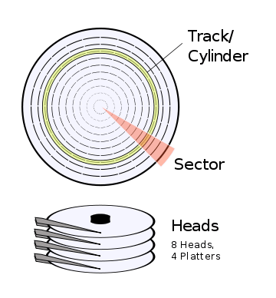
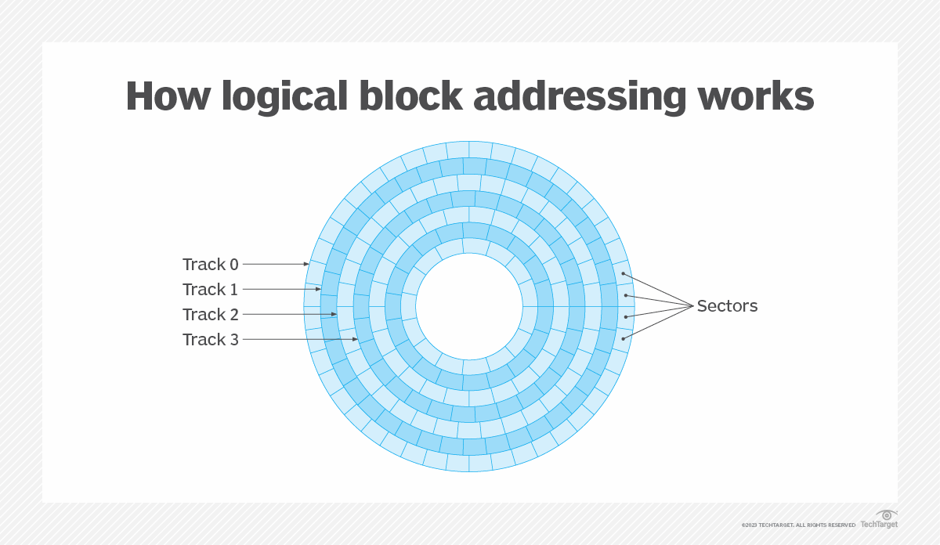
HDD : Cyliners, sectors and heads
HDD: To access various data stored on the hard drive, the operating system needs to be aware of which combination Cylinder-head sector the data is saved on.
The Logical Block Addressing scheme will be allocating blocks for data
The OS speaks to the LBA
More on that on week 6 or 7.

Slide 6
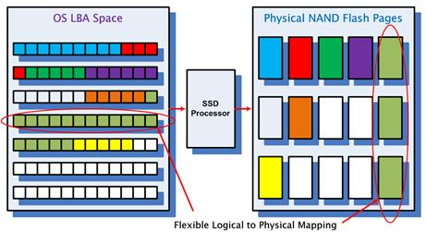
SSD Blocks
The LBA is the interface (driver) between the OS and the storage device.
It is the same for an SSD (so you usually don't need to install any special driver)

Slide 7
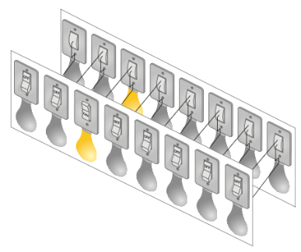
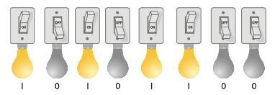
CPU Analogy: “Man in a Box”
Imagine we install a set of 16 lightbulbs
(8 inside, 8 outside).
These can be controlled by us and by the man-in-the-box. This is our external data bus (EDB).
We can communicate with each other as long as we agree ahead of time what each pattern of light bulbs means.

Slide 8
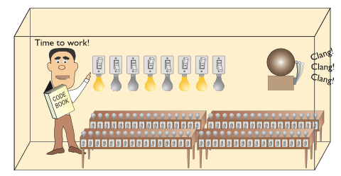
Clock
Now we are ready to put our man to work. We can send him the first command by lighting up the wires on the EDB.
But how does he know when we have finished setting up the light bulbs?

Slide 9
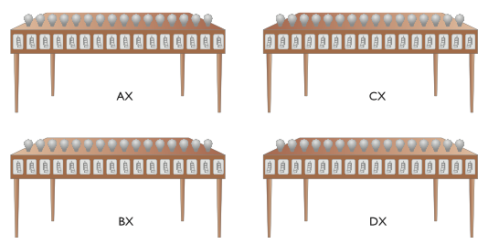
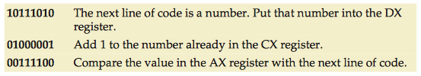
Registers & Codebook
Registers
We can give the man some work and see what he replies.
But to do his work, the man needs at least four workstations.
General purpose registers are the most common. AX, BX, CX, DX (Intel).
Codebook
This defines the commands that we can give to the man in the box.
If we both have a copy, then we can give him commands and he can understand them.

Slide 10
Clock
We can use a bell activated by a button.
A real computer uses a special wire called the clock wire (CLK). For the CPU to process a command on the EDB, a certain minimum charge is applied to the CLK wire. This is called a clock cycle.
The maximum number of clock cycles a CPU can handle in given period of time is called the clock speed.

Slide 11
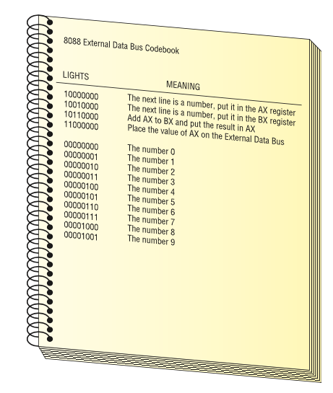
CPU Core Components: Activity
Using the following codebook, ask the “Man in a box” to calculate 2+3
You must send a series of commands to the CPU. The CPU will act on each command and give you an answer.

Slide 12
CPU Core Components: Activity (cont.)
10000000 The next line is a number, put it in the AX register 00000010 The number 2 10010000 The next line is a number, put it in the BX register 00000011 The number 3 10110000 Add AX to BX and put the result in AX 11000000 Place the value of AX on the external data bus
A set of commands such as this is called a program. A program is a series of command sent to a CPU in a specific order for the CPU to perform work.

Slide 13
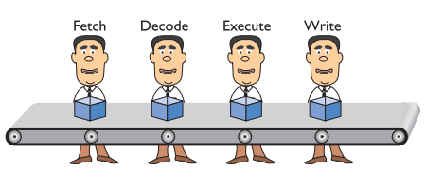
Pipelining
The CPU takes at least four stages (fetch, decode, execute, write/repeat) to do something. See https://en.wikipedia.org/wiki/Instruction_cycle for more detail Small discrete circuits inside the CPU handle each of these stages.
By organising these circuits in a conveyor-belt fashion (called pipelining), our “man-in-a-box” becomes “men-in-a-box”, thus improving efficiency.
Helps system to run faster. Not perfect and sometimes stalls. Some CPUs therefore have multiple pipelines.

Slide 14
CPU Core Components: Activity (cont.)
10000000 The next line is a number, put it in the AX register 00000010 The number 2 10010000 The next line is a number, put it in the BX register 00000011 The number 3 10110000 Add AX to BX and put the result in AX 11000000 Place the value of AX on the external data bus
A set of commands such as this is called a program. A program is a series of command sent to a CPU in a specific order for the CPU to perform work.

Slide 15
CPU Core Components: Activity (cont.)
Try it yourself:
Using the following codebook, ask the “Man in a box” to calculate 8 + 7
What parts of the previous program stay the same? What parts of the previous program need to change?

Slide 16
More Hardware Components to Discuss
More on CPU.
GPU.
Memory
Storage Devices.
In the near future!

Slide 17
For an ESD of 1 Byte, how many possible patterns?
1 Byte = 8 bits
1 | 2 | 3 | 4 | 5 | 6 | 7 | 8
1 | 0 | 1 | 1 | 0 | 1 | 1 | 1
2^8 = 256

Slide 18
Binary System

Slide 19
Outline
Binary System
Representing Numbers in Binary
Representing Negative Numbers in Binary
Binary Math
Boolean Logic & Logical Gates
Representing Text in Binary
Hexadecimal Numbers
Representing Color in Binary

Slide 20
The Binary System
In order to understand the Binary numeral system, we can compare it to something we already know: the Decimal numeral system.
In decimal, numbers are represented by combinations of ten different symbols: (0, 1, 2, 3, 4, 5, 6, 7, 8, 9). We call decimal a base 10 numeral system.
If we have more than “9” of something, another digit is needed (a new power of ten)u:
9 + 1 = 10
99 + 1 = 100, etc.
How do we represent numbers in binary?

Slide 21
The Binary System
In binary, there are only two symbols (0, 1). We call binary a base 2 numeral system. So if we have more than “1” of something, another bit is needed:
1 + 1 = 10 (in english: one plus one equals two)
11 + 1 = 100 (in english: three plus one equals four)
It’s counterintuitive at first! But there’s nothing fundamentally different about binary than decimal -- we’re just more used to using decimal instead.

Slide 22
The Binary System
Since we’re reusing symbols from the decimal system, there is a convention to use subscript to disambiguate between different numeral systems
1₂ + 1₂ = 10₂ is the same as 1₁₀ + 1₁₀ = 2₁₀ is the same as one plus one equals two
11₂ + 1₂ = 100₂ is the same as 3₁₀ + 1₁₀ = 4₁₀ is the same as three plus one equals four
This is not always required, but can be useful when the numeral systems are mixed in the same context.

Slide 23
The Binary System
Note: binary and decimal are not the only possible numeral systems. All that distinguishes numeral systems is the number of symbols you agree to use to represent numbers -- there are infinite possible numeral systems!
Hexadecimal is another useful numeral system (16 symbols, or base 16) which we will discuss later

Slide 24
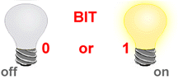
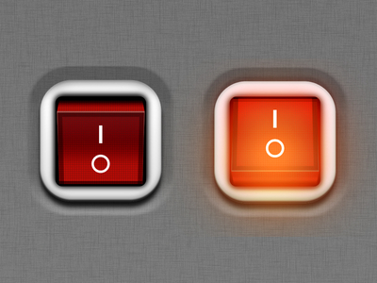
BIT – BInary digiT
So what does Binary have to do with computers?
Bit (Binary Digit) is the basic unit of information representing one of two discrete states.
The smallest unit of information within the computer.
Bit has one of two values:
0 (off) or 1 (on)
0 (False) or 1 (True)

Slide 25
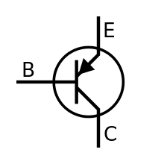
How are Bits Represented in a Computer?
Electricity will pass if current is above certain threshold
A transistor that is switched on or off
A capacitor that is charged or discharged.
On magnetic disks bits are represented by direction of the magnetic field (N-S, S-N).
Optical discs store bits optically (a bit on the surface is either shiny or not shiny).
Data is transmitted over telephone line or radio link using high- and low-pitched tones.
Controlled current
0
1
1
0
1
0
0
0
1
0
1
1
0
1
0
1

Slide 26
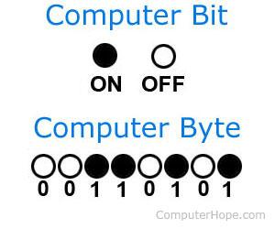
Byte
A Byte is a collection of bits known as the unit of digital information.
1 Byte = 8 bits
Abbreviation: B

Slide 27
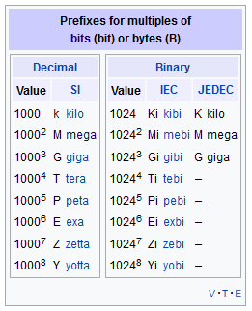
Byte Sizes
1 byte (B)
Kilobyte (KB) = 1,024 bytes (2¹⁰)
“one thousand bytes”
1,024 = 2 * 2 * 2 * 2 * 2 * 2 * 2 * 2 * 2 * 2
Megabyte (MB) = 1,048,576 bytes (2²⁰)
“one million bytes”
Gigabyte (GB) = 1,073,741,824 bytes (2³⁰)
“one billion bytes”
https://en.wikipedia.org/wiki/Byte

Slide 28
Representing Numbers in Binary

Slide 29
Converting Decimal Number to Binary
Divide a given decimal number by 2 using long division.
Note down the outcome and remainder of the division on the side.
Repeat steps 1 and 2 on the outcome until the outcome becomes zero.
The binary number will be the series of the remainders in the step 2.

Slide 30
Exercise: Converting Decimal Number to Binary
Convert 107 to binary.
double check you have the correct answer! google “107 in binary”

Slide 31
Recap Binary
Covert 25 to binary.
Long Division (divide the Outcome by 2 at every step):
Steps | Outcome | Remainder
1 | 25 | 1
2 | 12 | 0
3 | 6 | 0
4 | 3 | 1
5 | 1 | 1
Stop | 0
(25)₁₀ = (11001)₂

Slide 32
Exercises: Converting Decimal to Binary
Convert the following into binary:
10
64
128
146
300
1010
?
1000000
10000000
10010010
100101100

Slide 33
Exercise: Converting Binary to Decimal
Convert the following binary numbers to decimal:
1001
1101101
1000001
1111111
100000011000001
1001= 1x 2³ + 0 x 2² + 0 x 2¹ + 1x 2⁰ = 9
?
1101101= 1 x 64 + 1 x 32 + 1x 8 + 1 x 4 +1x 1 = 109
1000001 = 1 x 1 + 1 x 64 = 65
1111111 = 1 x 1 + 1 x 2 + 1 x 4+ 1 x 8 + 1 x 16 + 1 x 32 + 1 x 64 = 127*
16577 = 1 x 1 + 1 x 64 + 1 x 128 + 2¹⁴ = 255 +16384 = 16 639
Notes:
* Little trick to speed up the calculation: since all the binary values are 1, you can add determine 1111111 + 1 = 10000000 -­> 2⁷ = 256 , so 1111111 = 10000000 – 1 = 256 -1 = 255.

Slide 34
How many Numbers can I represent?
1 bit 🡪 can represent 2 numbers
(0)₂ = (0)₁₀
(1)₂ = (1)₁₀
2 bits 🡪 can represent 4 numbers
(00)₂ = (0)₁₀
(01)₂ = (1)₁₀
(10)₂ = (2)₁₀
(11)₂ = (3)₁₀
Values: 0 to 3 in decimal.

Slide 35
n Bits ⬄ How many Numbers
Exercise
How many numbers can I represent in 4 bytes? What is the first and last number?
n bits
Can represent 2^{n} numbers
Values: from 0 to (2^{n} -1)
1 Byte 🡪 8 bit 🡪 2⁸ numbers (256)
First Number 0000 0000₂ = (0)₁₀ to
Last Number 1111 1111₂ = 2⁸-1 = (255)₁₀

Slide 36
Binary Math & Representing Negative Numbers

Slide 37
Decimal Math: Addition
10,000’s 1,000’s 100’s 10’s 1’s
1 6 5 1 0
+ 1 6 5 9 5
-----------------------------
3 3 1 0 5
1 1 1

Slide 38
Binary Math: Addition
64’s 32’s 16’s 8’s 4’s 2’s 1’s
1 1 1 0 1 0
+ 1 1 0 1 1
-----------------------------
1 0 1 0 1 0 1
Double check using the decimal numbers.
Dec
58
+ 27 -------
85
1 1 1 1

Slide 39
Decimal Math: Addition – try it yourself
1. 101 + 11 =
2. 111 + 111 = 3. 1010 + 1010 = 4. 11101 + 1010 = 5. 11111 + 11111 =
1000 1110
10100
100111
111110

Slide 40
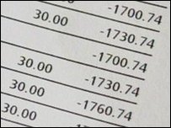

Negative Numbers (signed numbers)
Not all numbers are positive.
Winter weather temperatures in Canada ☹
Bank accounts … ☹☹☹
Computers need to represent both positive and negative numbers.

Slide 41
Negative Numbers
In computers, an integer number is represented using
32 bits (4 bytes)
32 bits can represent: 2³² - 1 = 4,294,967,295 numbers
Most computers use the first bit for the sign:
1 for negative
0 for positive
Use the remaining 31 bits for the number itself

Slide 42
Unsigned vs signed
1 | 2 | 3 | 4
1 | 0 | 1 | 1
Bit for sign (+/-) | 2 | 3 | 4
1 | 0 | 1 | 1
Unsigned (positives only)
Signed
(positives and negatives)
Min: 0
Max: 15
Min:-7
Max: 7

Slide 43
Simple Way
32 bits
1 bit for the sign
31 bits = 2³¹ - 1 = 2,147,483,648 numbers
Example:
Decimal Binary
173 00000000 00000000 00000000 10101101
-173 10000000 00000000 00000000 10101101
Most significant bit 0 -> +
1 -> -

Slide 44
Simple Way: Representation with 4 bits
There are some problems with the “Simple Way”, however....
What happens when we do math?
( 5 ) 0101
+ ( -5 ) + 1101
----------- ---------
0 1010
( 6 ) 0110
+ ( -2 ) + 1010
----------- ----------
4 0000
1 1 1 1 -7
1 1 1 0 -6
1 1 0 1 -5
1 1 0 0 -4
1 0 1 1 -3
1 0 1 0 -2
1 0 0 1 -1
1 0 0 0 -0 Negative zero??
0 0 0 0 0 Zero appears twice!
0 0 0 1 1
0 0 1 0 2
0 0 1 1 3
0 1 0 0 4
0 1 0 1 5
0 1 1 0 6
0 1 1 1 7

Slide 45
Fixing the “Simple” Method: Two’s Complement
Eg. : - (-20)₁₀
How many bits do we need?
Rule of thumb: if left most bit is “1”, add an extra bit! (because negative numbers should always start with 1, and positive numbers should always start with a 0)
(20)₁₀ = (10100)₂ 🡪 (010100)₂
2. Invert all the bits in step 1:
010100 🡪 invert 🡪 101011.
3. Add 1 to the inverted value
101011 + 1 = 101100
therefore, (-20)₁₀ = (101100)₂

Slide 46
Fixing the “Simple” Method: Two’s Complement
Eg. : (-5)₁₀
Process: how to represent (-5)₁₀ in binary using two’s complement:
Find the binary value for the positive value of the given number, using all the bits made available to us (so if there is one byte, use all 8 bits)
(5)₁₀ = (0000 0101)₂
Invert all the bits in step 1:
0000 0101 ➔ invert ➔ 1111 1010
Add 1 to the inverted value
Inverted binary = 010 + 1 🡪 (-5)₁₀ = (1111 1011)₂

Slide 47
Two’s Complement: Representation with 4 bits
1 0 0 0 -8
1 0 0 1 -7
1 0 1 0 -6
1 0 1 1 -5
1 1 0 0 -4
1 1 0 1 -3
1 1 1 0 -2
1 1 1 1 -1
0 0 0 0 0
0 0 0 1 1
0 0 1 0 2
0 0 1 1 3
0 1 0 0 4
0 1 0 1 5
0 1 1 0 6
0 1 1 1 7
Let’s do some math operations:
( 5 )
+ ( -5 )
-----------
( 6 )
+ ( -2 )
-----------

Slide 48
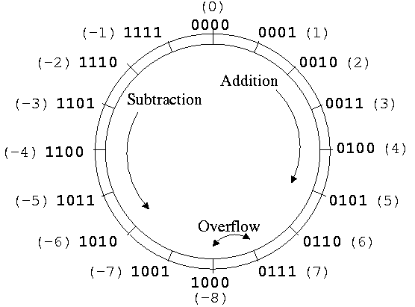
Another way of looking at it

Slide 49
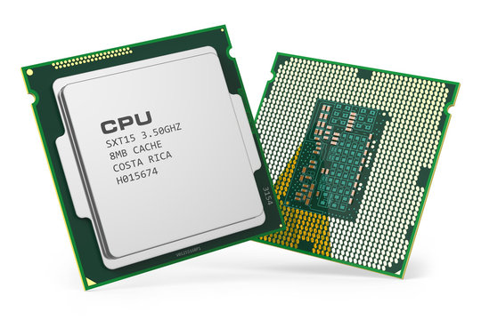
Why use Two’s Complement?
Two’s complement simplifies hardware
Signed and unsigned operations are handled the same way for additions, subtractions and multiplication*
* With the condition that the product required to keep the same number of bits as operands

Slide 50
Review - How do we calculate 4 + (-20) in binary?
Step 1. Converting 4 and 20 to binary
Steps | Outcome | Remainder
1 | 4 | 0
2 | 2 | 0
3 | 1 | 1
Stop | 0
(4)₁₀ = (100)₂
Steps | Outcome | Remainder
1 | 20 | 0
2 | 10 | 0
3 | 5 | 1
4 | 3 | 0
5 | 1 | 1
Stop | 0
(20)₁₀ = (10100)₂

Slide 51
Review - How do we calculate 4 + (+20) in binary?
Add the two binary numbers while keeping the most significant bit
000100
+010100
----------
011000 -> (24)10

Slide 52
How do we calculate 4 + (-20) in binary?
Apply Two’s Complement to 20₁₀ (10100)₂
How many bits do we need?
Rule of thumb: if left most bit is “1”, add an extra bit! (because negative numbers should always start with 1, and positive numbers should always start with a 0)
(20)₁₀ = (10100)₂ 🡪 (010100)₂
Invert all the bits in step 1:
010100 🡪 invert 🡪 101011
Add 1 to the inverted value
101011 + 1 = 101100
therefore, (-20)₁₀ = (101100)₂

Slide 53
Review - How do we calculate 4 + (-20) in binary?
Add the two binary numbers while keeping the most significant bit
000100
+101100
----------
110000

Slide 54
How do we calculate 4 + (-20) in binary?
Check your answer, convert back to decimal
110000₂ is a negative number (begins with ‘1’) -- so first let’s apply the Two’s Complement rule to make it positive again.
Invert all the bits:
110000 -> invert -> 001111
Add 1 to the inverted value 001111 + 1 = 010000
Convert to decimal
010000 = 2⁴ = 16
This means we correctly calculated: 4 - 20 = -16 [end of solution]

Slide 55
Decimal Math: Using Two's complement
(-32)10 =
(50)10 + (-32)10 =
(64)10 + (-4)10 =
(100)10 + (-220)10 =
(-32)10 = (1110 0000)2
(0011 0010)2 + (1110 0000)2 = (0001 1100)2
(0100 0000)2 + (1111 1100)2 = (0011 1100)2
(0000 0110 0100)2 + (1111 0010 0100)2 = (1110 0000)2

Slide 56
Subtracting using the human method
6. 110 – 10 = 100 7. 101 - 11 = 10 8. 1001 -11 = 110 9. 1101 -11 =1010 10. 10001 -100=1101

Slide 57
Substraction using the CPU method
6. 110 – 10 = 7. 101 - 11 = 8. 1001 -11 = 9. 1101 -11 = 10. 10001 -100=
6. 0110 +(– 0010) = 7. 0101 + (-0011) = 8. 01001 + (-00011) = 9. 01101 +(-00011 )= 10. 010001+(-000100)=
6. 0110 +(1110) = 0100 7. 0101 + (1101) = 0010 8. 01001 + 1101) =0110 9. 01101 + (11101)=01101 10. 010001+(111100)=
001101
Two’s compliment
Using regular addition

Slide 58
Decimal Math: Substraction

